Slide 1
Notes for Author
(remove this slide before submission)
• Files to Submit:
1. High-resolution poster file (PDF or PNG).
2. Video file with your poster and voice-over presentation (MP4 or similar.)
• Use this File Naming Convention for this PowerPoint file: “Category-Author Last Name, Author First Name (2025)”
Use these Category Codes:

Slide 2

Poster Title
Author First Name, Last Name
Credentials
College of Nursing, if student
© NAFNP 2025

Slide 3


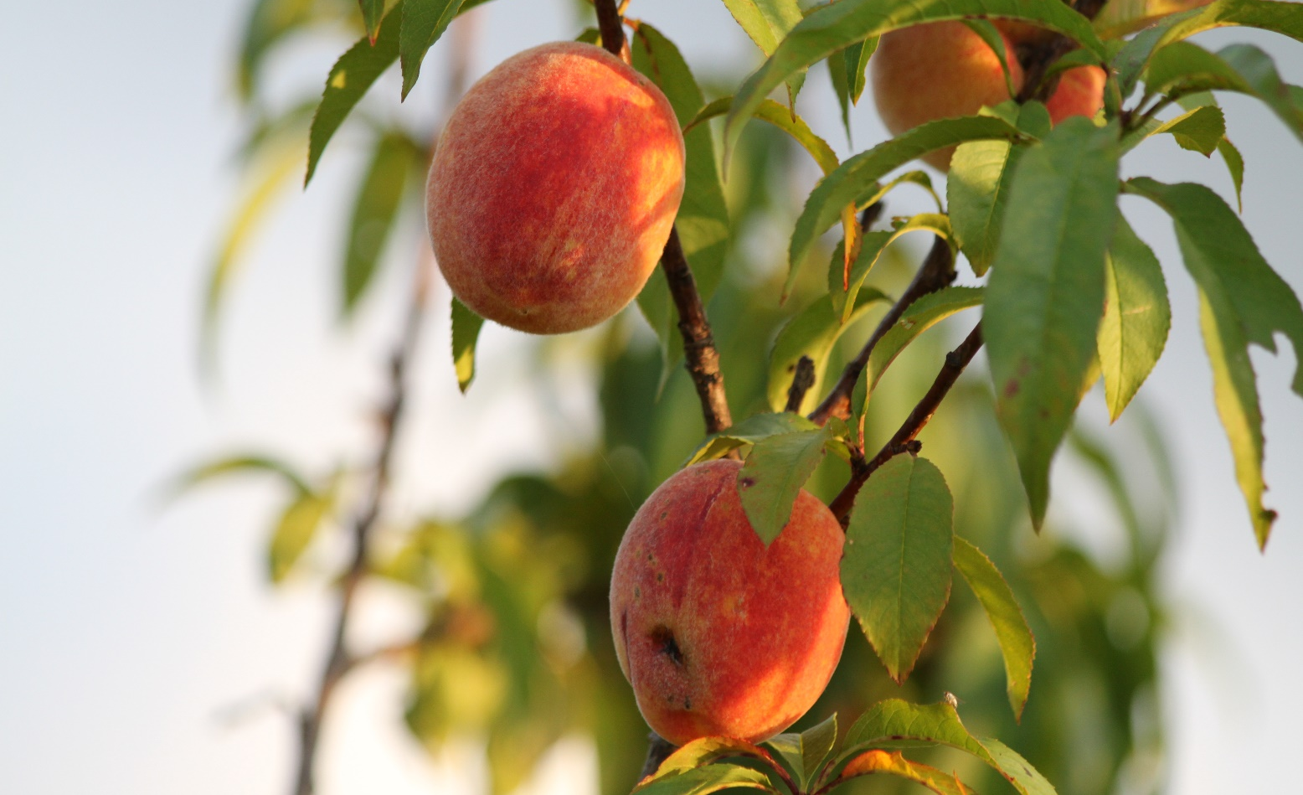
1920 x 1080 px Poster Setup: for Virtual Presentations
A title may continue on the second line
A. FirstAuthor¹; B. SecondAuthor²
Summary sentence of your poster goes here
INTRODUCTION
METHODS
Results
Virtual Poster Size: 1920 x 1080 pixels (20inx21.25in) for online viewing.
Font sizes used in this template:
  headings: 18pt
  text box fonts: 16pt
  table fonts: 14pt
  figure fonts: 12pt
  reference list fonts: 12pt
Consistency: Font type and size in all text boxes should be the same. You can use smaller font in tables and references but not smaller than 14 pt.
Reducing verbiage: Instead of making the font smaller in text boxes to fit more text, think of ways to distill the essence of what you want to convey with less text
Guides: use guides to align all text boxes and images vertically and horizontally. To turn on guides, click “View” and check “Guides”.
Resizing Images proportionally: hold down “Shift” key while dragging corner handle. Avoid dragging width and height handles separately.
Break up the bullets with infographics, icons, tables, diagrams or pictures:
Is this clearly
legible?
Check clarify in
display mode
Too much text
in bullets?
Make use of
infographics
Picture worth a
thousand words
Were do I find a
graphics sample?
pexels.com for one,
unsplash.com, etc.
Examples of sites offering free images:
  https://unsplash.com/
  https://www.cleanpng.com/
  https://www.pexels.com/
Conclusions
This layout is aimed at helping you determine the amount of text that will fit into a VIRTUAL 1920 x 1080-pixel poster while leaving enough white space and using font size comfortable enough to read in display mode.
ADDITIONAL HEADING
You may need to include another heading in addition to the main headings, Introduction, Methods, Results, and Conclusions.
If you do not need an additional heading, you can add a picture to use up white space or expand the content of the previous text box.
Tables: Use as large, sans-serif font as possible. Check clarify in display mode.
Table 1. Title of Table (14 pt font, center vertically)
 | HEADING | HEADING
Heading | data | data
Heading | data | data
References
References should use the APA style
Insert Your Acknowledgements Here | You can also place references here if there is not enough space above

Slide 4
References
Acknowledgements
© NAFNP 2025

