Slide 1
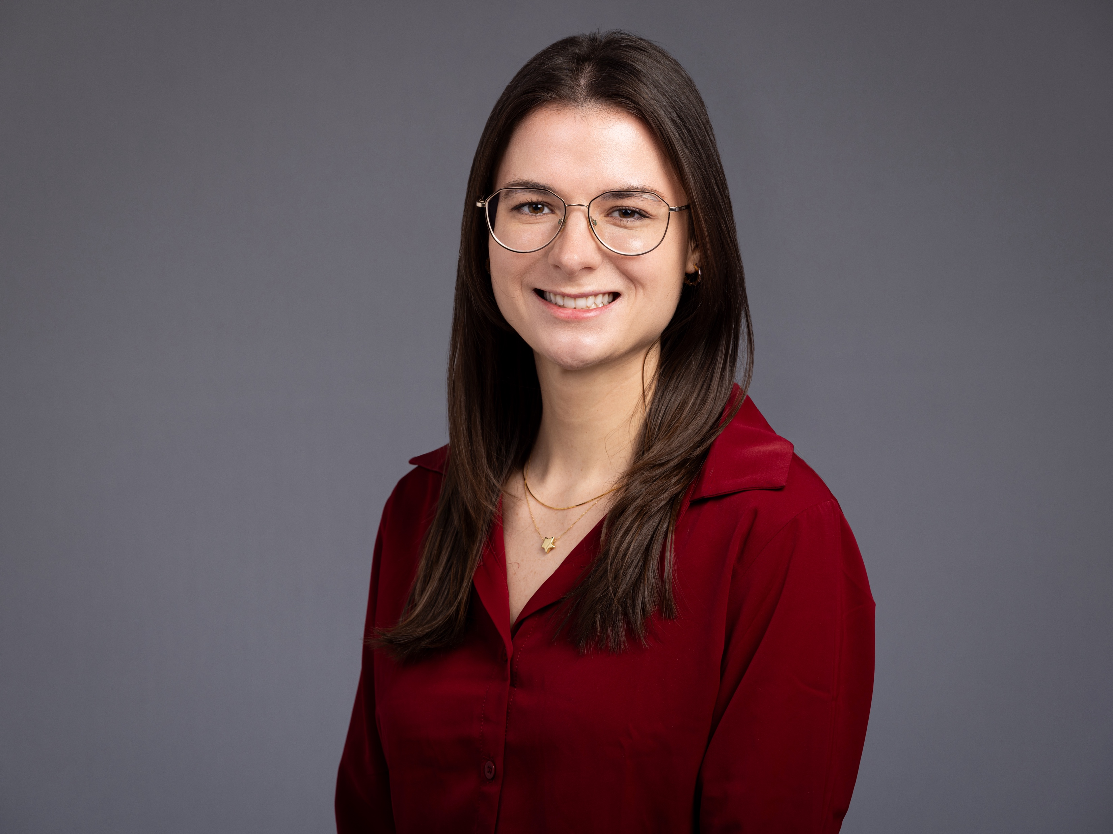
Author Biographies
Kaylyn Lunneborg DNP, RN
Kaylyn Lunneborg is a recent Doctor of Nursing Practice Family Nurse Practitioner graduate from Rush University College of Nursing. Her background includes a 7-year nursing career in hematology/oncology as well as extensive clinical training in general cardiology, electrophysiology, endocrinology, and internal medicine in urban academic and community-based environments. As president of the Lifestyle Medicine Student Interest Group and program leader of the Cardiometabolic Health Initiative, she has led initiatives focused on chronic disease prevention and management through community and group-based, lifestyle-focused care. Her DNP project—Designing a Blood Pressure Management System for Adult Employees with Uncontrolled Hypertension—integrates population health strategies, interdisciplinary collaboration, and systems-based practice to improve outcomes within a large urban academic hospital. Her work was presented as a poster at the 2024 Lifestyle Medicine Conference and accepted for publication in the American Journal of Lifestyle Medicine.
© NAFNP 2025

Slide 2
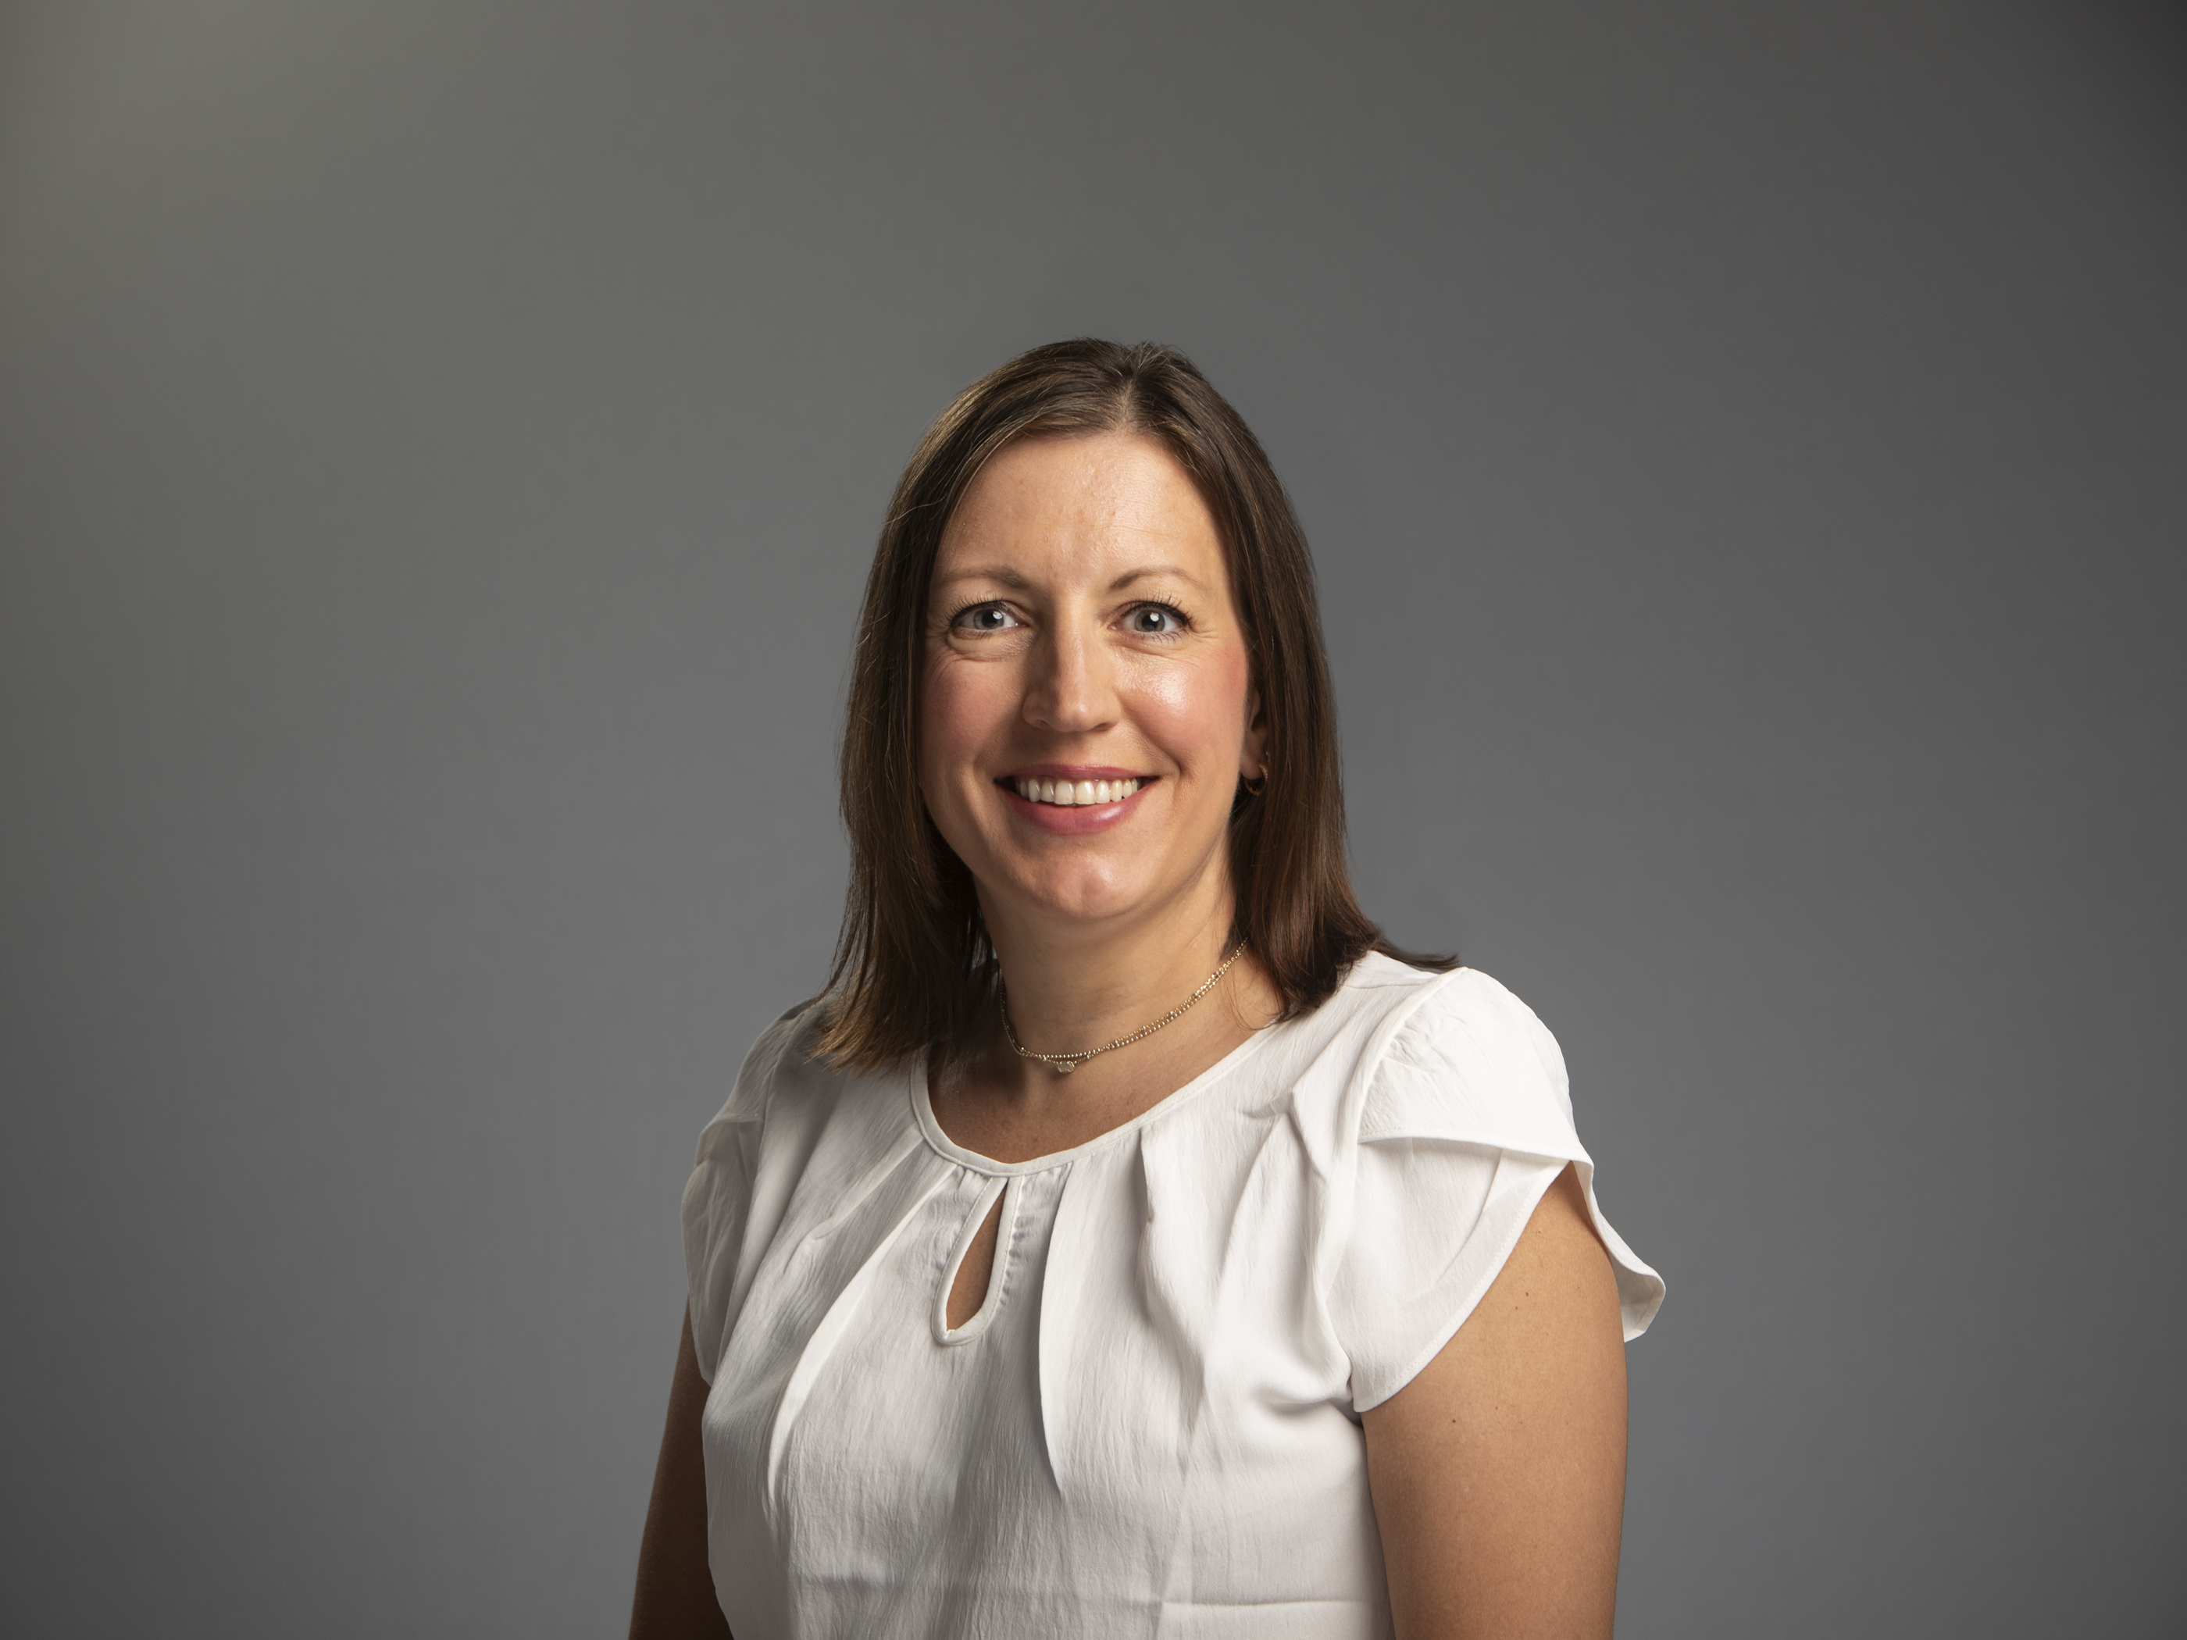
Author Biographies
Elizabeth Simkus DNP, FNP-C, DipACLM
Dr. Elizabeth Simkus, DNP, FNP-C, DipACLM, is a board-certified family nurse practitioner and Diplomate of the American College of Lifestyle Medicine. She is the Medical Director of the Rush Prevention Center and an Assistant Professor at Rush University College of Nursing, where she brings over 14 years of clinical experience in preventive care and bariatric health. As a leader in lifestyle medicine, Dr. Simkus integrates evidence-based approaches to nutrition, physical activity, sleep, mental health, and substance use to prevent and reverse chronic disease.
Dr. Simkus served as the primary project facilitator and faculty reader for this DNP project. Her clinical expertise, systems-level insight, and leadership in innovative care delivery were integral to the project’s development and successful implementation. She continues to lead interdisciplinary efforts that advance population health through patient-centered, sustainable interventions.
© NAFNP 2025

Slide 3
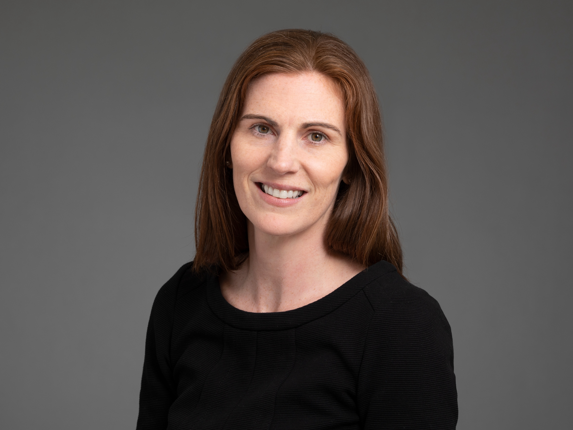
Author Biographies
Amy Haeger DNP, FNP-BC
Dr. Amy Haeger, DNP, FNP-BC, is a board-certified family nurse practitioner and Assistant Professor in the Rush University College of Nursing, where she has served as an educator and clinical leader since 2019. With over 25 years of experience at Rush University Medical Center, Dr. Haeger leads collaborative, interdisciplinary care. Currently, she works at Rush Associates in Women's Health. Dr. Haeger teaches in the DNP program with a focus on diagnostic reasoning and advanced clinical management courses.
As the academic advisor for this project, her mentorship, clinical insight, and commitment to academic excellence were essential to its development and successful completion. Her leadership continues to shape future nurse practitioners through evidence-based practice, clinical scholarship, and systems-level thinking.
© NAFNP 2025

Slide 4

Acknowledgements
Kaylyn Lunneborg DNP RN, completed this project while completing her studies at Rush University College of Nursing. This work represents her DNP project. Special thanks to Amy Haeger, Elizabeth Simkus, Beth Zinda, and Ada Xhuba for their invaluable insights and support throughout the project discussions.
© NAFNP 2025

